Slide 1
Realtime Interview Q&A
Here is where you can find actual Power BI Q&A

Slide 2
How would you use Power BI to analyze customer behavior and identify trends to improve the effectiveness of our marketing campaigns?
Connect Power BI to relevant data sources like CRM, website analytics, or marketing platforms.
Create visualizations to analyze customer demographics, purchase history, and engagement metrics.
Utilize Power BI's AI capabilities to perform customer segmentation based on behavior patterns.
Identify trends in customer preferences, product interests, and peak activity periods.
Measure the effectiveness of marketing campaigns by tracking conversion rates and ROI.
Use funnel visualizations to analyze customer journey and optimize conversion points.
Incorporate sentiment analysis of customer feedback to gauge campaign impact on customer satisfaction.
Present findings and actionable insights to marketing teams for data-driven campaign improvements.

Slide 3
How would you handle data inconsistencies or data quality issues when working with Power BI for analyzing customer behavior and trends?
Conduct data profiling and validation to identify inconsistencies or quality issues.
Work with data owners or data engineers to rectify and clean the data at the source.
Implement data transformation steps in Power BI to handle missing or invalid values.
Utilize calculated columns or measures to standardize data formats and resolve inconsistencies.
Apply data filters or slicers to exclude irrelevant or erroneous data from visualizations.
Use data alerts to monitor unexpected changes or inconsistencies in real-time.
Regularly review and validate data quality metrics to ensure accuracy and reliability in reports.
Document data cleaning processes and collaborate with stakeholders to maintain data integrity.

Slide 4
How would you leverage Power BI to track and evaluate the performance of our sales team?
Connect Power BI to relevant sales data sources, such as CRM or sales databases.
Create visual dashboards to track key sales metrics like revenue, leads, and conversion rates.
Utilize slicers or filters to allow easy analysis by salesperson, region, or time period.
Implement drill-down capabilities to explore performance details at individual sales rep levels.
Use KPI visualizations to monitor sales targets and performance against goals.
Incorporate trend analysis to identify growth or decline patterns in sales performance.
Utilize geographic maps to visualize sales distribution and identify potential growth areas.
Regularly review the sales team's performance through Power BI and use insights to make data-driven decisions.

Slide 5
How would you use Power BI to analyze customer churn and devise strategies to reduce it?
Import and integrate relevant customer data, including churn and engagement metrics, into Power BI.
Create visualizations to analyze churn rates over time and identify trends or patterns.
Utilize customer segmentation to identify high-churn customer groups.
Implement predictive analytics to forecast potential churn and proactively address risks.
Analyze customer behavior and interactions to understand factors influencing churn.
Create dashboards to monitor customer satisfaction and feedback to identify potential churn triggers.
Utilize Power BI's AI capabilities to identify key drivers of churn.
Devise targeted retention strategies based on insights gained from the analysis.

Slide 6
How would you use Power BI to analyze and optimize the supply chain process in order to improve efficiency and reduce costs?
Integrate data from various supply chain sources into Power BI, including inventory levels, production data, and transportation details.
Create visualizations to analyze key performance indicators (KPIs) like inventory turnover, lead times, and supplier performance.
Use Power BI's forecasting capabilities to predict demand and optimize inventory levels.
Implement geographic maps to track product movement and identify potential bottlenecks.
Utilize drill-down features to explore specific areas for inefficiencies and cost-saving opportunities.
Analyze historical data to identify seasonality patterns and optimize production schedules.
Collaborate with stakeholders to create actionable insights and implement process improvements.

Slide 7
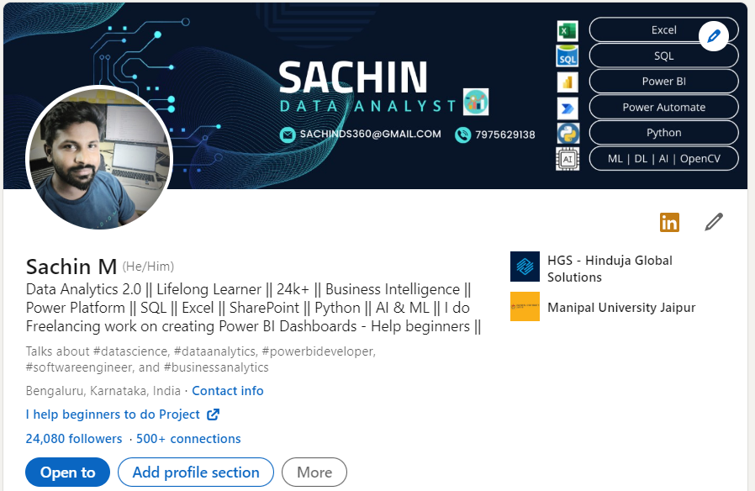
Thank You Connect me on LinkedIn

